Slide 1
Fine-tuning Language Models
for Social Scientists
Shiyu Ji @ NetCon
2024.3.8

Slide 2
So, What is a Language Model (LM)?
Assume w as a sequence of words that is used by human, and w_i as the ith token of the sequence
A Language Model models language… Technically, it approximates P(w), with varying assumptions
Anything falls in this category is a LM!
A very simple model: P(w_i) = Cat for any i (0 parameter involved)
A slightly complicated model: P(w_i) ~ Distribution from word frequency in the vocabulary (Unigram Model)
Bigram model: P(w_i|w_i-1) with conditional independence
Parameter counts for the above model?

Slide 3
(Word) Embeddings
Issue with N-gram model
We need a vector of dimension |V| to represent each word (All Standard Basis Vectors -> Sparse vector may help)
Hard to capture semantic similarities between words
Now… Word Embeddings
Assumption: Semantically similar words share the same context words
Advantage: Dense vectors with lower dimensions that could capture similarities (via cosine similarity)
Existing methods: Word2Vec, GLoVe…
That's a lovely dog!
That's a cute dog!

Slide 4
In Search of More Advanced Embeddings
This a bottle of still water.
We're still waiting for our new couch to be delivered.
In a lot of cases, the same word has different meanings
To deal with this issue, LSTM (Recurrent neural network) based bi-directional language model (P(w_i|w_1, w_2,...w_{i-1}) * P(w_i|w_{i+1}, w_{i+2},...w_{n}) ) was deployed to create such embedding, called ElMo

Slide 5
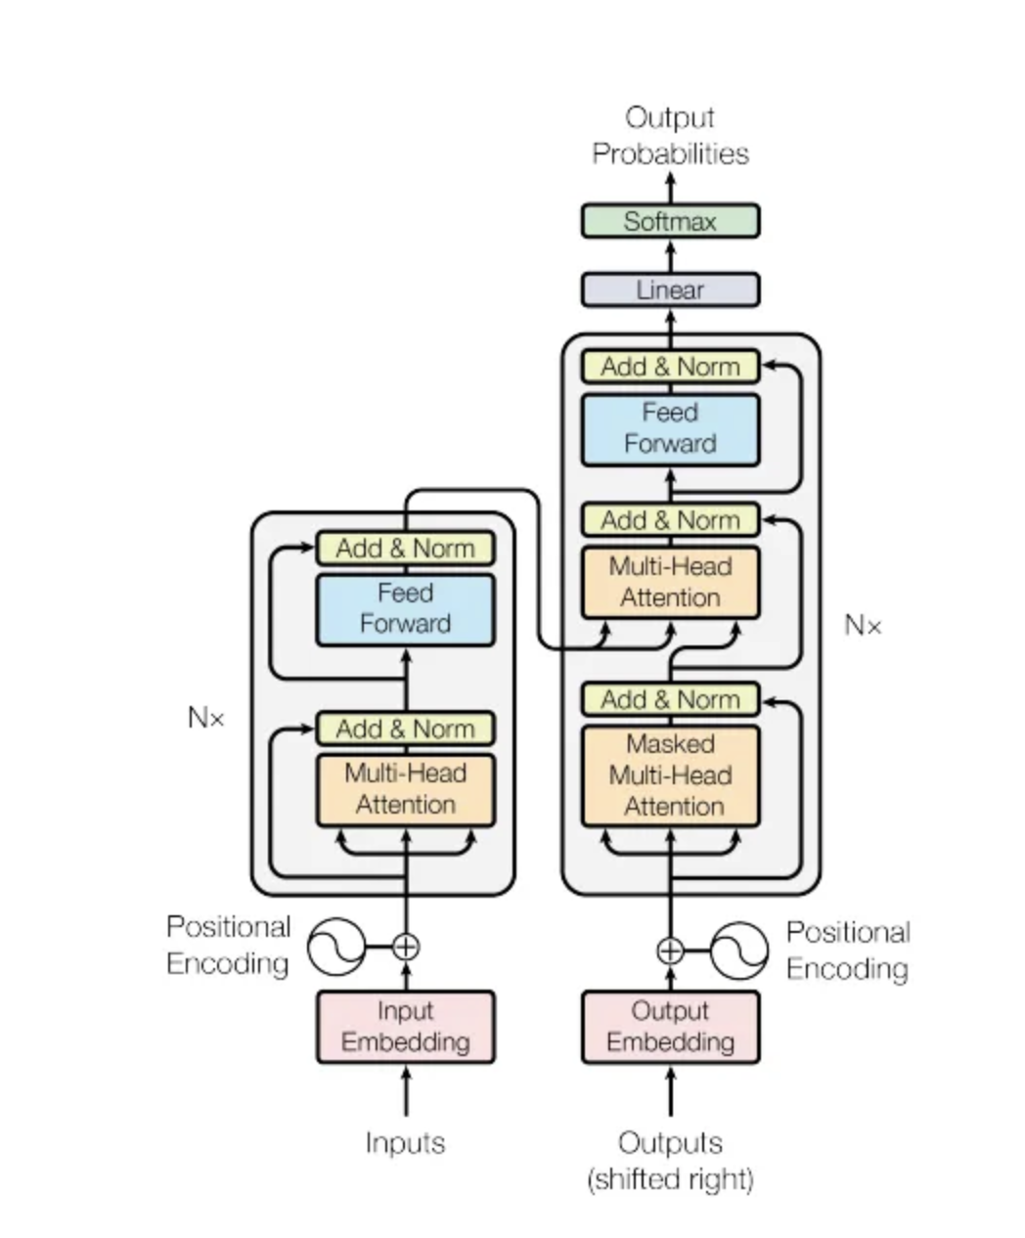
Transformers: Attention is All You Need
Issues with Recurrent Neural Networks
Very hard to parallel between examples (RNNs runs for the length of each sentence, and this differs across examples)
Very hard to back-prop: Since the gradient at one step is strictly dependent on the gradient in the previous step.
Attention-based language models resolve the above issue
Highly parallelizable
Short back prop chain length
Features self-attention mechanism and cross-attention mechanism

Slide 6
Transformers
The original model could be divided in 3 configurations
The encoder-only structure encodes the information included in every token in dense vector forms: Modeling P(w_i|w_1, w_2, …, w_{i-1}, w{i+1}, …, w_n)
The decoder-only structure predict new tokens based on the previous tokens: Modeling P(w_i|w_1, w_2, …, w_{i-1}, x)
The encoder-decoder model combines the two, encode the information and generate new tokens based on the summarized information.

Slide 7
Transformers
The original model could be divided in 3 configurations
The encoder-only structure: BERT, RoBERTa that generate token-specific embeddings or classifies a whole sentence (Parameter size: 110M/340M)
The decoder-only structure: GPT families (Sentence generation based on the previous words) (Parameter size: 175B/1.7T)
The encoder-decoder model: T-5 (Translation tasks, QA tasks…)
I would be cautious when calling BERT/RoBERTa Large Language Models
encoder
decoder

Slide 8
Transformers
Magic about these models (in general)
Comparing to simpler models with much smaller parameter size, the model is less prone to the issue of overfit

Slide 9
Pre-trained Models and Fine-tuning
Fine-tuning a Language Model: Using a language model trained on a large corpus (pre-trained model) and update the model parameter to adjust it to a specific task

Slide 10
BERT Model: Masked Language Model
Training objective 1: Masked language model task
Replacing 15% of the tokens in the sentence and predict the word using the stacked encoders connected by softmax activations that project to discrete tokens
Example: That's a lovely dog!
We predict lovely from
That's a [MASKED] dog! (80% Masked token)
That's a bakery dog! (10% Random Token)
That's a lovely dog! (10% Original Token)
This gives a context-specific embedding for each token in the sentence.

Slide 11
BERT Model: Masked Language Model
Training objective 2: Next Sentence Prediction Task
Predict whether two sentences are following each other, using the embedding generated for the [CLS] token at the beginning to perform a binary classification task with activation function
Example: [CLS] Memes gained increasing prevalence and relevance as the internet and social media grew. [SEP] They allow people to rapidly spread humorous, interesting, or sarcastic videos, images, or posts to others around the world.
Example Task: [CLS] Embedding -> Activation Function -> Yes
* Example from: https://www.investopedia.com/meme-stock-5206762

Slide 12
BERT Family Usage Examples
Generalized on Task 1: Generate token-wise embedding and prediction
Semantic Role Labelling
Named Entity Recognition
Argument Component Labelling
Generalized on Task 2: Classification task based on a whole sentence
Sentiment Analysis
Toxicity Classification

Slide 13
A Classical Fine-tuning Pipeline
Could be wrapped by HuggingFace Helpers
Pre-process Data and Create Labels
Tokenize Data
Training Model
Select Model
Split data into train/eval/test sets
(8/1/1 or 98/1/1 or other configurations depending on data size)
Split sentences into the token units corresponding to pre-trained model’s default token maps
BERT Used Word-piece tokenizer
The core-part: Update the model parameters
Train different models based by different parameters
Choose the model with the best performance on eval set
Only use test set once!!

Slide 14
Training Principles: Use Your Resource Wisely
Batch Size Selection: Choose the size that fits your GPU (typically 2^n)
Training Hyperparameter selection: Some hyperparameter search ()
Low-precision training: Fp-16 or bf-16 training, available depending on GPU type (about 2x increase in number of examples included for each iteration)
Transfer learning whenever possible: If there is an existing model that works well and share the same input and output feature, use that directly!
Not necessarily training all layers
Understand the Pre-trained Model Objective and Do Your Cost Function Correctly!!

Slide 15
Final Remarks: Garbage in, Garbage Out
A task’s learnability is always your first consideration when you decide to train your model
Could human recognize this discrepancy you want to learn?
How good is the task (than random guesses? Then existing methods?)
This relates to my research:
In social sciences, we could not always assume that the data is totally separable

